Slide 1

The Voices of Samoans
Unit 5

Slide 2

Overview
Topics
Samoan responses to Mead
Emic and etic perspectives
Unit Learning Objectives
Compare the different responses Samoans had to Mead’s work
Inspect how “outsider” anthropologists represent “the other” and the consequences of this on global views

Slide 3
Introduction
In this unit (to accompany the SAPIENS podcast S6 E3), students will compare the different responses of Samoans to Margaret Mead’s work and her publications on Samoa. Using Mead as a guide, students will inspect how “outsider” anthropologists and ethnographers examine cultures different from their own and the significance this has on global views of various cultures. Students will examine the way Samoans, being the insiders in the culture, viewed an outsider's perspective on their culture and the conclusions Mead drew. This concept of insiders and outsiders will be further examined to explain how conclusions made by outsiders shape the global view of non-Western cultures.

Slide 4
Samoan Reactions
Paul Shankman notes several Samoan reactions to Mead’s work and even her name, including the following:
Misrepresented—Mead was not Samoan and could not speak for them.
Angry—Several Samoans have challenged Mead’s representations of their culture. One scholar felt Mead portrayed Samoans “like animals.”
Used—Mead did not need consent to write about the Samoan people and many dislike that they were written about at all.
Resentment—Mead portrayed Samoan girls as sexually
permissive.

Slide 5
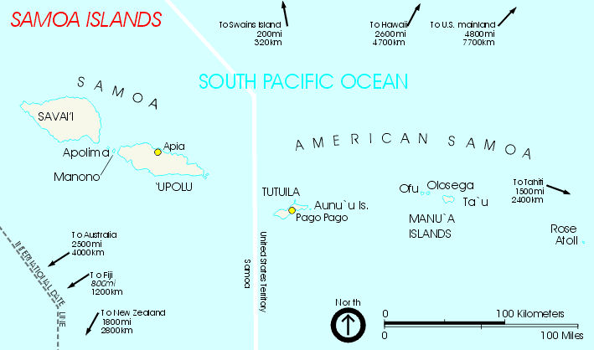
Insider vs. Outsider
Emic: An insider perspective to a culture
Etic: An outsider perspective to a culture
Mead’s book, and the later controversy with Derek Freeman, illuminated the issue of outsiders studying a culture

Slide 6
Freeman vs. Mead
Both Freeman and Mead presented their work as understanding Samoan culture. However, Samoan’s have argued that both outsider anthropologists got things wrong.

Slide 7
Global Views
Both Mead and Freeman published with an American audience in mind.
Mead’s book was popular in America among the masses. As such, many Americans view of Samoa and its people was influenced by Mead’s conclusions.
This gave Westerners a false view on Samoan culture.

Slide 8

Wrap-Up
Let's put this all together!
Many Samoans were displeased with Mead’s representations of their culture. Nevertheless, Mead was popular in America and her conclusions shaped Western views.
Think about Samoans’ negative responses to Mead’s work, and even to Freeman’s critique. How might things have been different if Mead had collaborated with a Samoan academic?

